Slide 1

ANTI-BULLYING WEEK 2012
YOU, ME AND US

Slide 2


Slide 3


Imagine…

Slide 4


Natalie’s story: No escape from bullying

Slide 5


Let’s be honest…

Slide 6

Banding together

Slide 7

More than just a word

Slide 8

What we can do

Slide 9
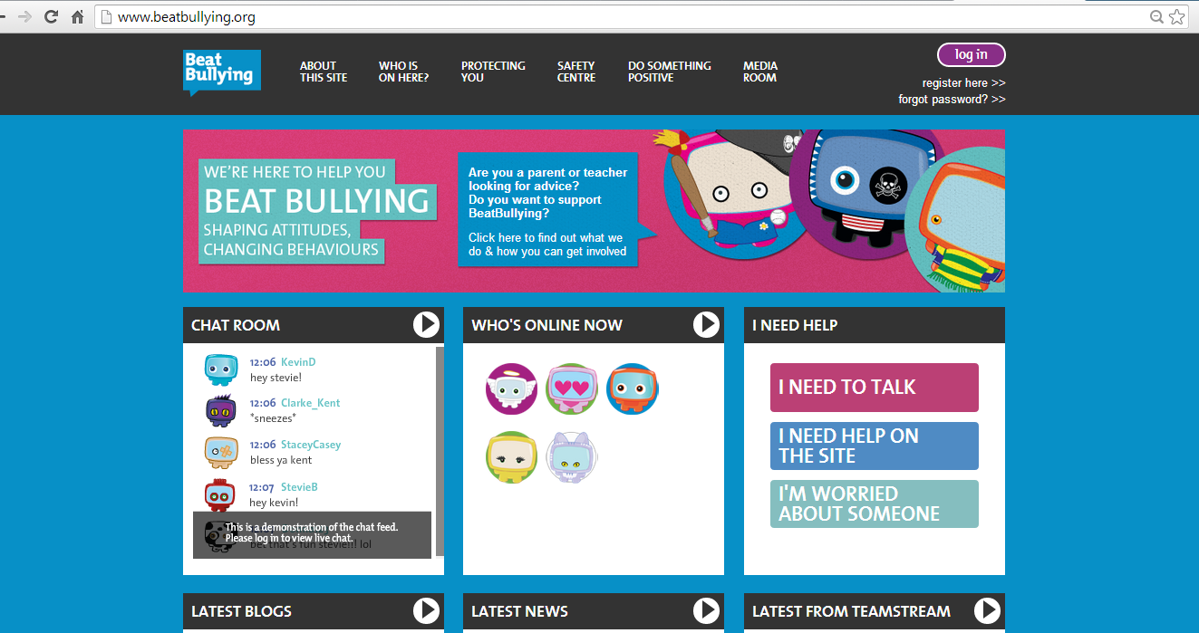
Want to talk about Bullying?
Log on to www.beatbullying.org

Slide 10

One last point…FLY

